Slide 1
SRPMIC Community Development Department Planning Services Division presents to the Land Management Board
Use Variance Application
Case 25-UV-01
Rancho Solano Middle School – Use Variance
May 27, 2025

Slide 2
Agenda
Applicant’s Request
Use Variance Application
What is a Use Variance?
Use Variance Findings
Next Steps

Slide 3
Applicant’s Request
Tim Scolaro with Orcutt Winslow Architects, as the applicant, is requesting a use variance to allow a middle school within The Pima Center, which is zoned C3-PC.
Per the SRPMIC Zoning Ordinance, a public or private school, K-12 grade is not an allowed use in the C3 zoning district unless a use variance is granted.

Slide 4
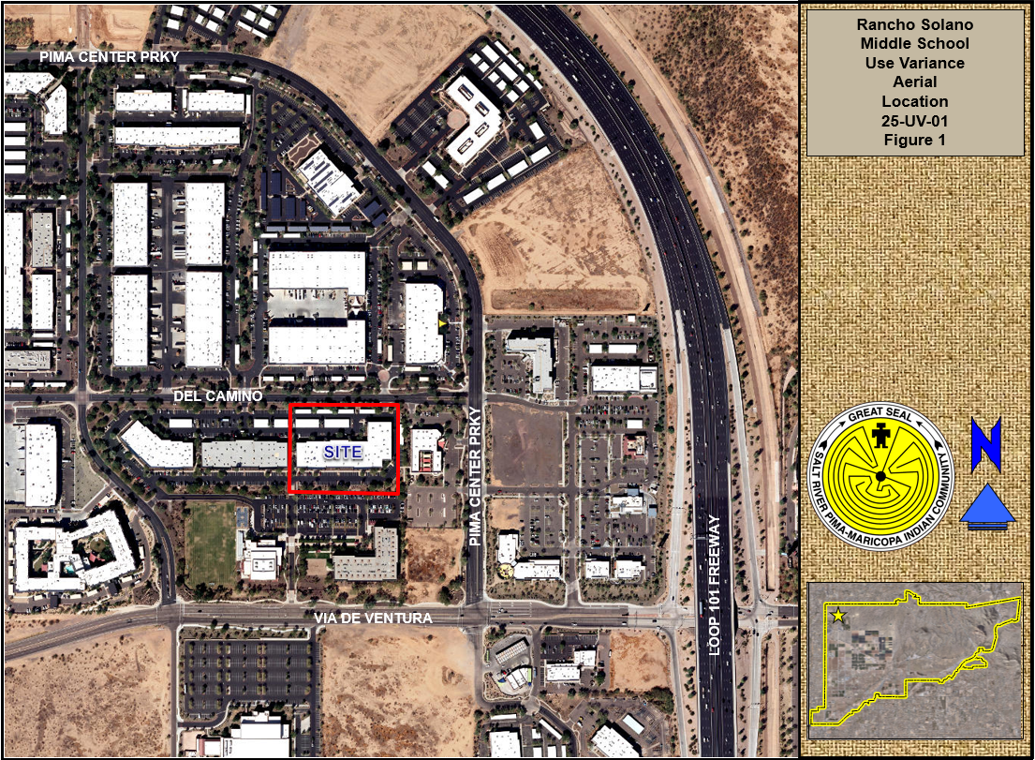
Aerial Map

Slide 5
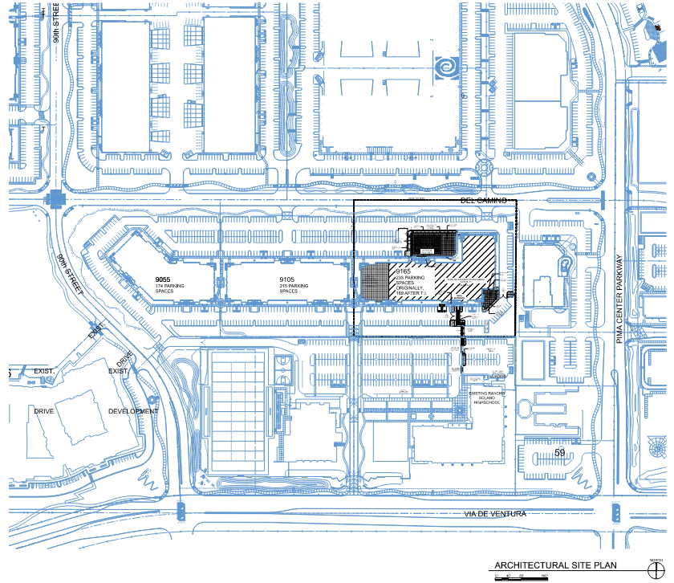
Conceptual Site Plan

Slide 6
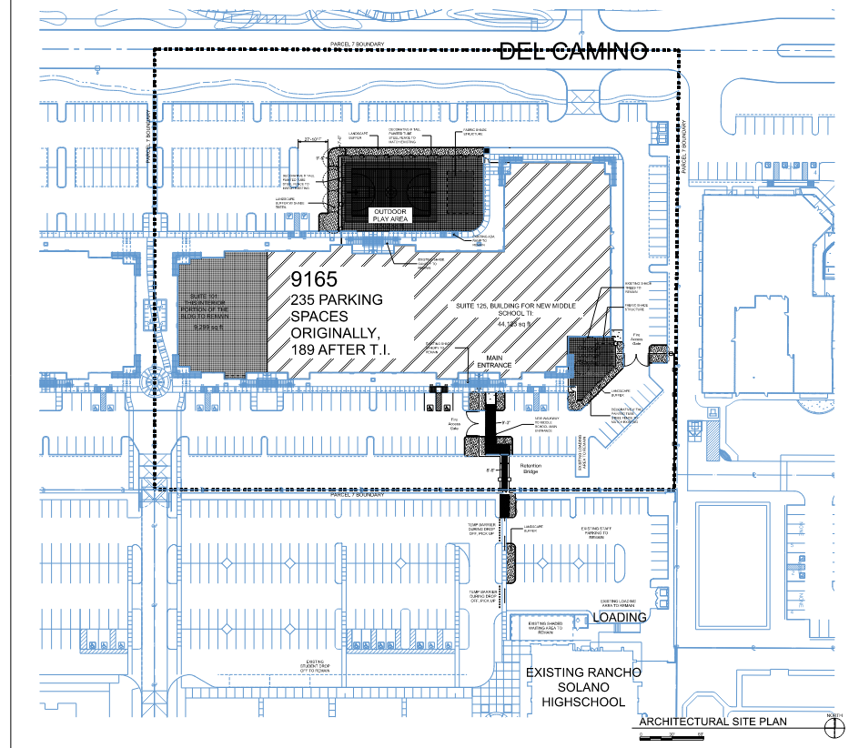
Conceptual Site Plan

Slide 7
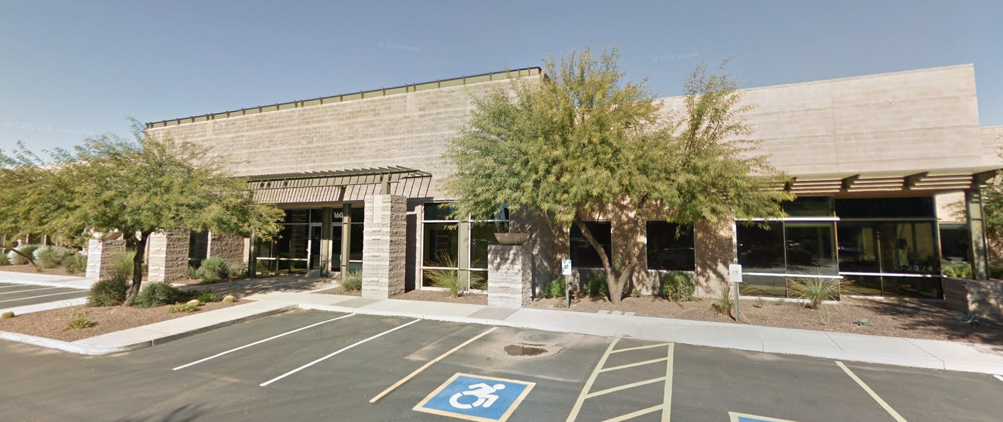
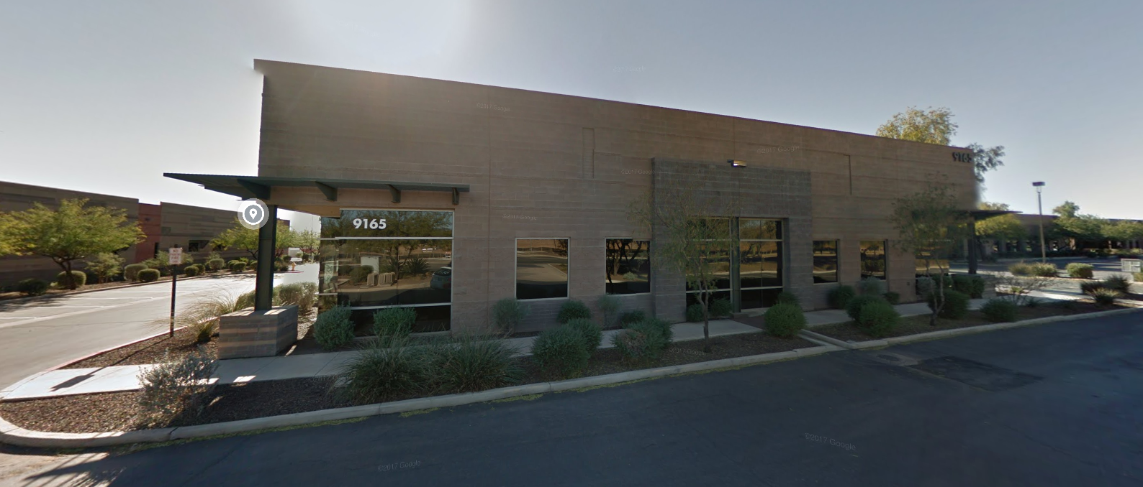
Existing Building –
9165 E Del Camino Drive

Slide 8
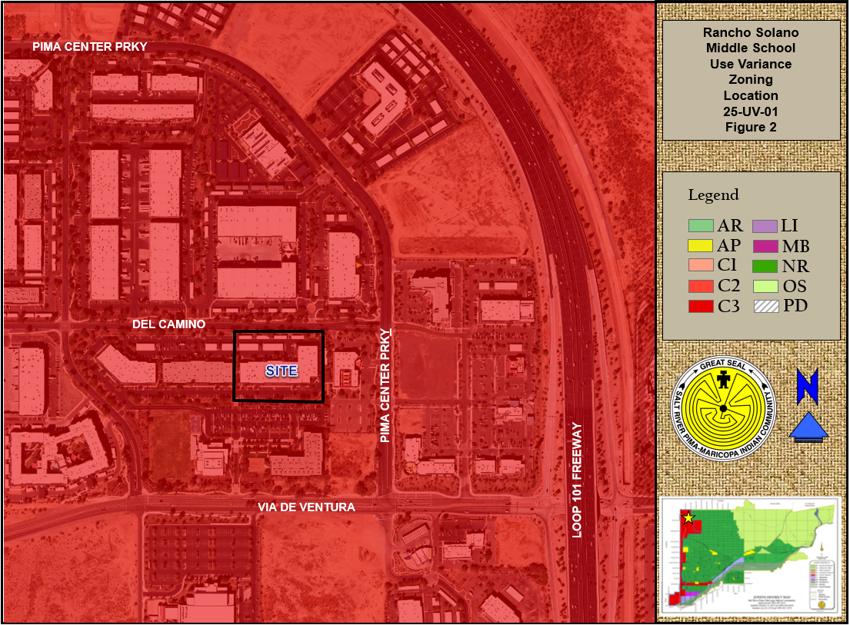
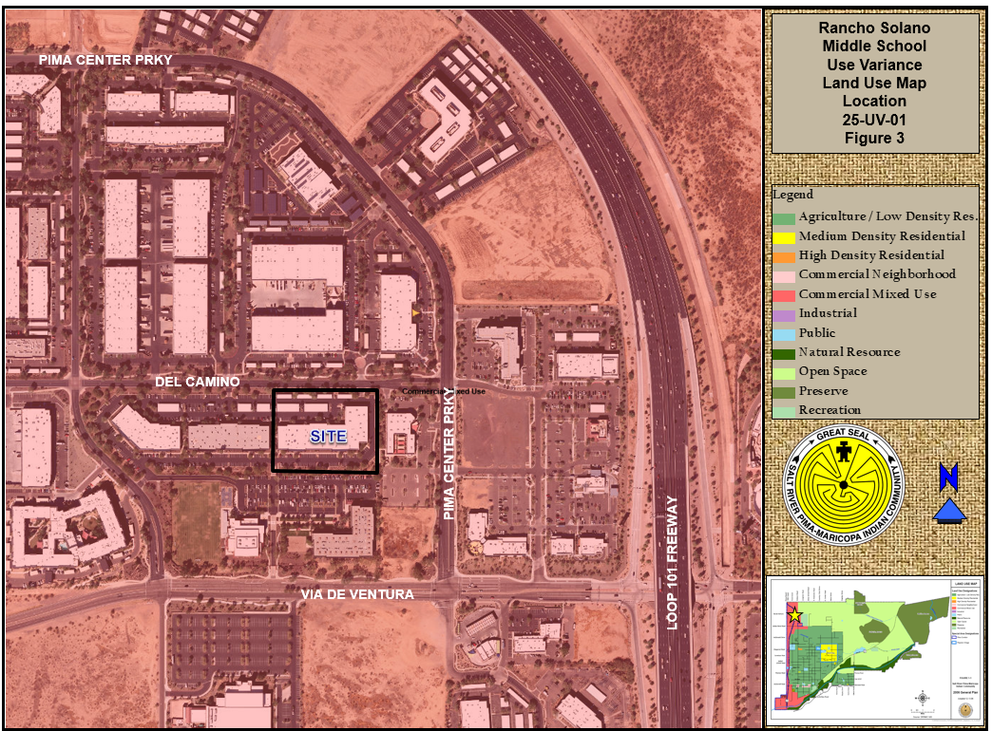
Zoning
General Plan

Slide 9
What is a Use Variance?
A specific use that is not listed as allowed, allowed with conditions, or allowed with a conditional use permit in a particular zoning district may be allowed through a use variance.
A use approved by a use variance may not be changed, altered or increased in intensity except as specifically approved by the Community Council through the approval process in Article 2.3 and 2.5.
The Community Council may approve a use variance if it finds that the five (5) findings required in Section 2.10.3 have been met.
Applicants for a use variance must address any adverse impacts the use may have on the surrounding area, such as:
Nuisance arising from noise, smoke, odor, dust, vibration, light trespass, glare or electromagnetic static.
Hazards to persons and property from possible explosion, contamination or fire.
Volume, type or character of traffic unusual for the area.
Visual impacts.

Slide 10
Use Variance Requirements
1. The characteristics of the proposed use, its scale, intensity, architecture, appearance and hours of operation are compatible with the uses existing or permitted in the surrounding area.
Located north of the existing Rancho Solano school.
Proposing to move into an existing building at 9165 East Del Camino Drive, which currently resembles an office building. No exterior changes to the architecture of the building are proposed.
A small playground will be incorporated into the site for the use of the middle school students.
Hours of operation would be 7am-4pm, which is somewhat similar to the surrounding office uses.

Slide 11
Dimensional Variance Requirements
2. The proposed use is not detrimental to the public health, safety or welfare of surrounding areas or injurious to the existing or future allowable uses or improvements of adjacent properties in the zoning district.
Currently there are two Rancho Solano schools within the Pima Center. This proposed middle school would make three.
Existing uses surrounding this area are predominately office, with the exception to a dog kennel (The Barking Dog) to the east.
The new middle school use will utilize the existing drop off and pick up locations from the main school campus. Schedules will be staggered to accommodate this.
A pedestrian connection will be built from this area to the proposed school location to the north.

Slide 12
Dimensional Variance Requirements
3. The Community would derive greater benefit from the use in the proposed locations than it would if the use were located in an existing zoning district in which it is located.
Rancho Solano will continue to offer full scholarships to Community members. With this proposed middle school use, scholarships would increase since there would be more students.
As noted previously, there are currently two Rancho Solano schools within the Pima Center. With the proposed middle school, this would increase the campus.
Students and parents frequent the adjacent restaurants and retail. With this expansion, this would increase the visitation and increase the amount of revenue from taxes collected.

Slide 13
Dimensional Variance Requirements
4. Adequate infrastructure to serve the use exists in the proposed location, or the applicant can demonstrate that adequate infrastructure will be provided or addressed by an acceptable means.
Applicant has stated that there is adequate infrastructure onsite to serve this proposed use.
A traffic impact analysis (TIA) was prepared and reviewed to demonstrate this proposal would be acceptable for this area.
Current water and sewer lines are sufficient for this proposal.
Current fire lanes and fire apparatus roads meet current requirements.

Slide 14
Dimensional Variance Requirements
5. Any adverse impacts of the proposed use on surrounding properties will be adequately mitigated in a way that will not require a burdensome or extraordinary level of enforcement or monitoring.
As noted above, drop off and pick up locations are existing at the current school and this proposed use would utilize this location along with having staggered schedules.
A new pedestrian connection will be established for this new use.
The middle school use will not generate loud noises nor will it cause any issues with dust or vibration.

Slide 15
Recommended Stipulation
Based on this proposal, staff is recommending the following stipulation:
1. All proposed improvements onsite shall conform to the development requirements found in the SRPMIC Zoning Ordinance.

Slide 16
Environmental Review
The Environmental Protection & Natural Resources Division (EPNR)/CDD have on file a Request for Environmental Review (RER).
Based on this review, CDD – EPNR has determined that there are no environmental or archaeological concerns known for this specific area.

Slide 17
Next Steps
SRPMIC Council Notification
SRPMIC Council Community Hearing
SRPMIC Council Determination

Slide 18
Thank you!
Contact information:
Rick McAllister, CDD/PSD Principal Planner
E-mail: richard.mcallister@srpmic-nsn.gov
Telephone: 480-362-7655
Adam DeCook, CDD/PSD Manager
E-mail: adam.decook@srpmic-nsn.gov
Telephone: 480-362-2707

