Slide 1
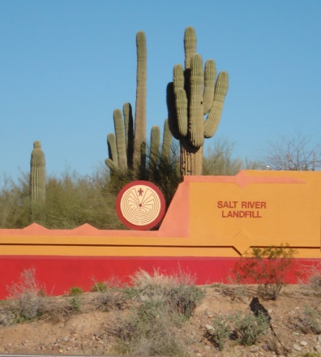
The Future of the Landfill
Summer/Fall 2023

Slide 2
Why are We Here?
I...I...I
Inform
Invite
Initiate

Slide 3
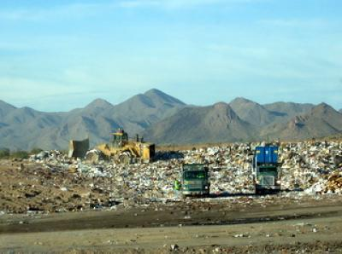
Inform
About the Salt River Landfill
(SRLF)
What It Is vs What It is Not

Slide 4
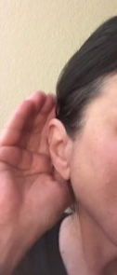
Invite
Questions from Community Members
Feedback for Tribal Council

Slide 5
Initiate
A strategic plan for the
future of SRLF.

Slide 6
Inform

Slide 7
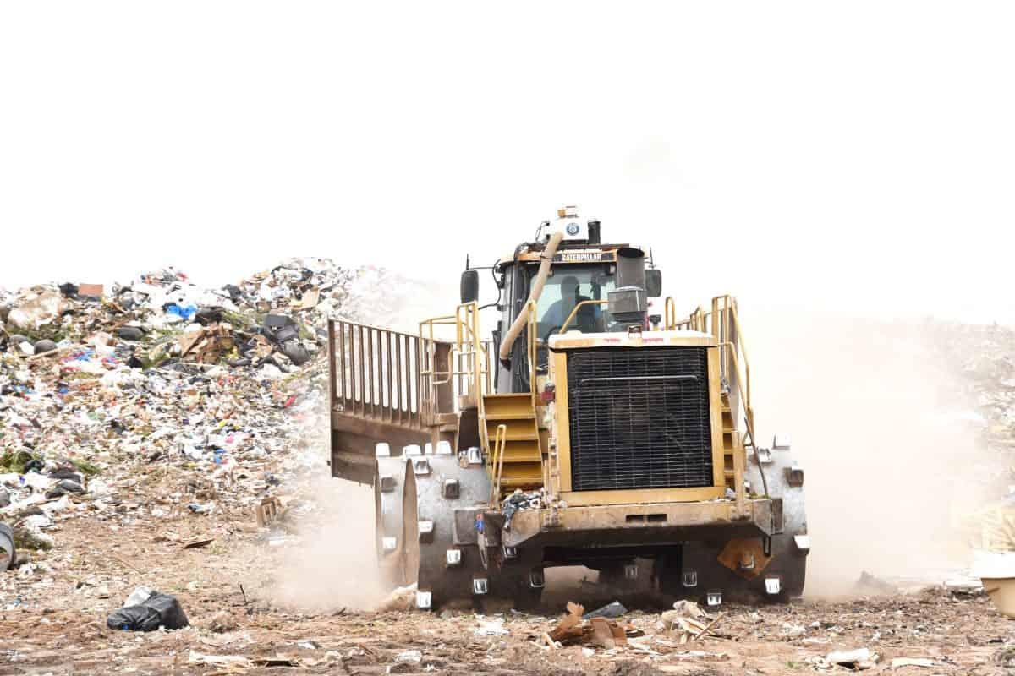
Inform
The Salt River Landfill
does not accept liquid waste.
SRLF accepts:
Solid waste (garbage)
Construction and demolition debris
Yard waste, dirt, rocks, appliances and electronics
*Most waste comes from SRPMIC, Scottsdale, and Mesa.

Slide 8
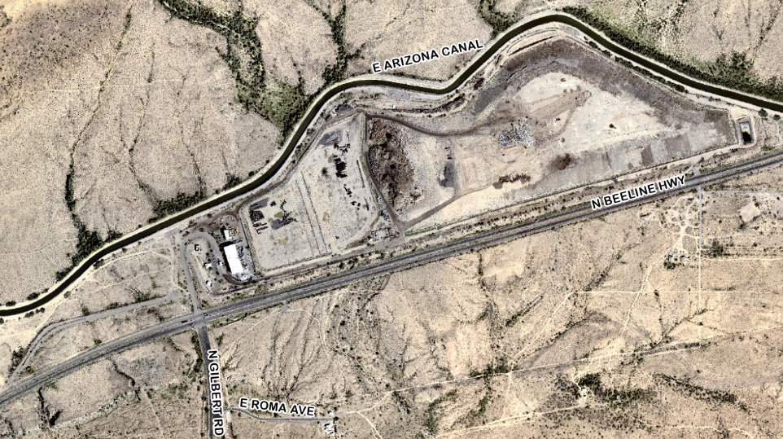
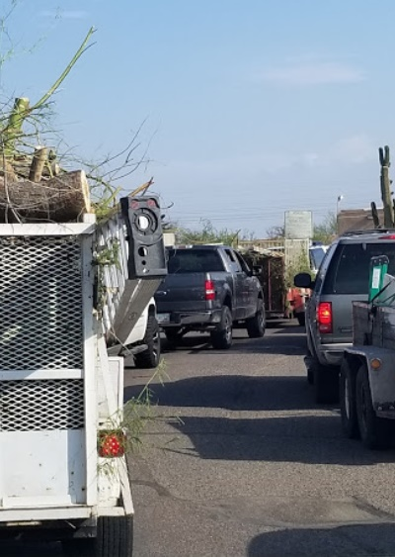
Inform
The Salt River Landfill has been open for
20 years.
Salt River Landfill has been open at its present site since 1993—30 years.

Slide 9
Inform
The landfill follows
Environment Protection Agency (EPA)
Regulations to safeguard air quality for the Community and surrounding areas.

Slide 10
Inform
The landfill does not pose a
significant risk of polluting
Community groundwater.
SRLF operates under Subtitle D of the Resource Conservation and Recovery Act (RCRA).

Slide 11
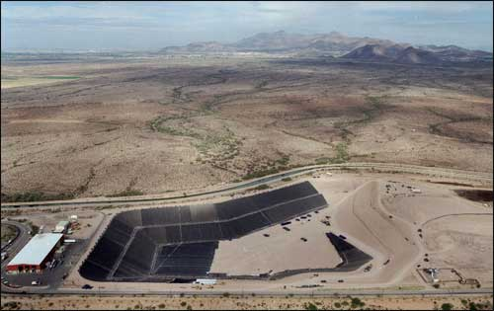
Protecting Groundwater
Landfills cannot be located near flood plains,
wetlands, on a geological fault, etc.)
The bottom of the landfill is covered in a
thick layer of non-degradable liner to prevent
liquids from contacting soil.
Liquids (i.e. leachate) are constantly suctioned
off the bottom to further limit incursion risk.
Groundwater under and near the landfill is checked regularly to ensure it’s clean and free of contamination.
The landfill does not except hazardous waste (e.g. paints, oils, and chemicals)

Slide 12
Inform
In 2012, Council authorized an additional 60 feet of height to the landfill.
This means the landfill is approved to rise 140 ft. above natural ground level.

Slide 13
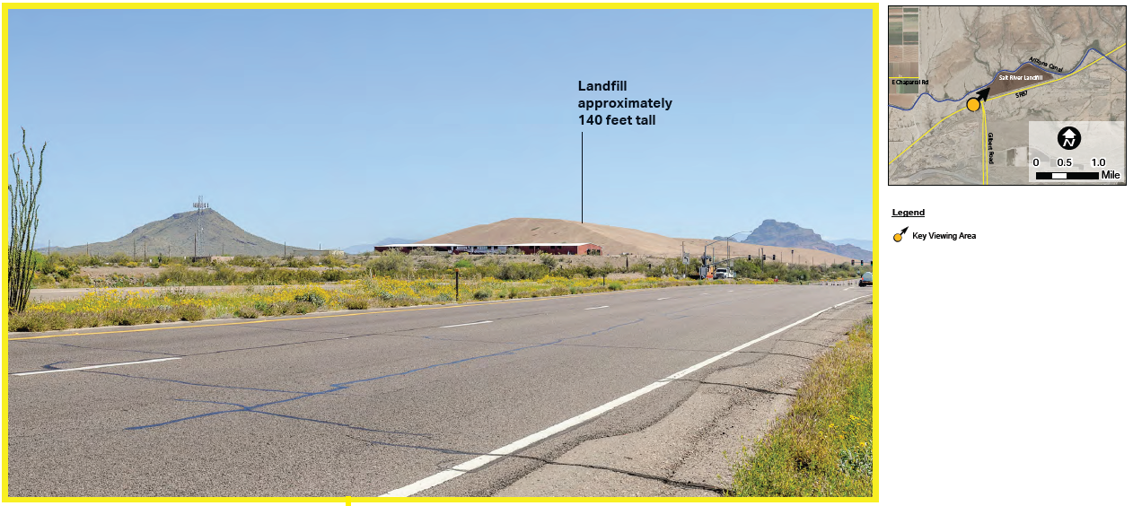
Projected Full Height - Looking East on SR87

Slide 14
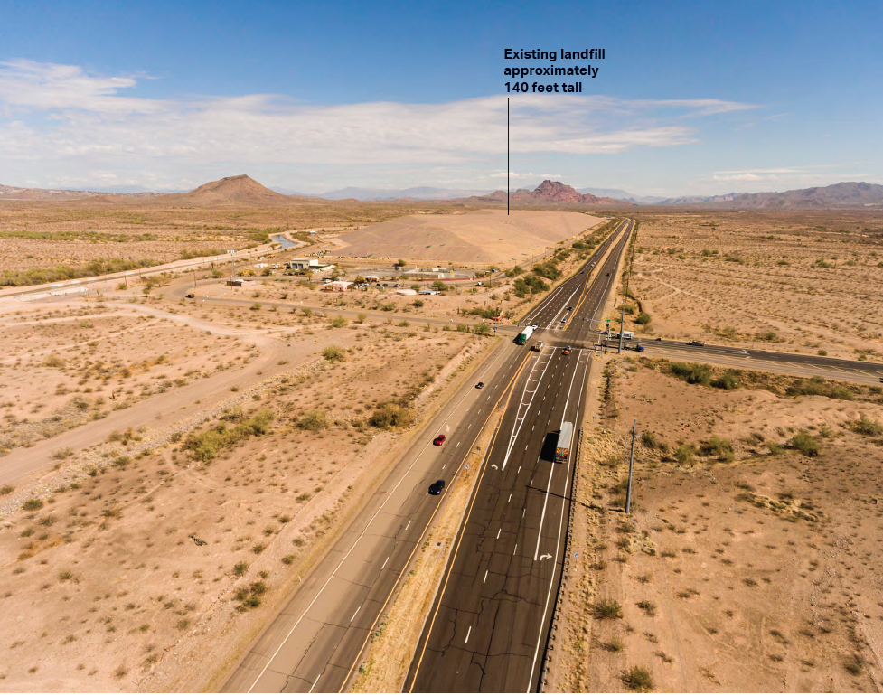
Aerial— Projected full height. Looking East along SR87

Slide 15
Inform
The landfill does not own or
operate the recycling facility.
Republic Services leases land from the Community to operate a recycling facility.
It serves SRPMIC, Scottsdale, and Mesa.
Destroyed by fire in 2019, it is expected to reopen in Fall 2023.

Slide 16
Inform
The landfill provides the 2nd
highest non-gaming revenues to
the Community.
The landfill provides:
14% of all non-gaming enterprise payouts.
The 3rd highest net income of all Community enterprises.
A recession resistant business.

Slide 17
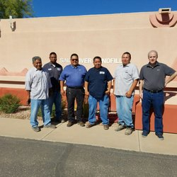
Inform
The landfill has the highest Community
member (CM) employment rate of all
SRPMIC enterprises.
80% of our staff support a CM household.
$2.1M in annual salaries and benefits.
94% of our staff support a CM or Native American household.
$2.6M in annual salaries and benefits.

Slide 18
Inform
There are many productive
uses for the landfill after it
closes.
There are many options for the landfill when it closes.
Return to undisturbed open space and wildlife habitat.
Repurpose and reuse (multiple options).

Slide 19
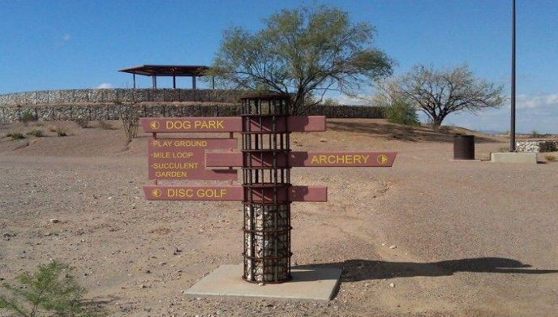
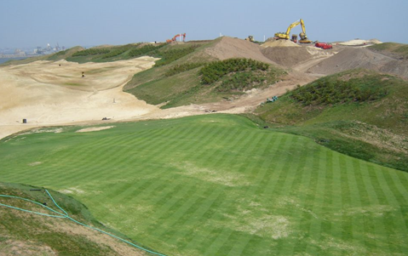
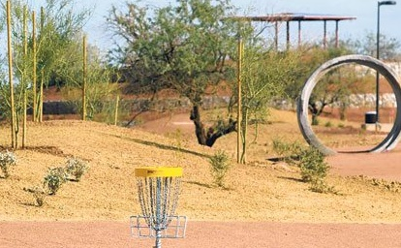
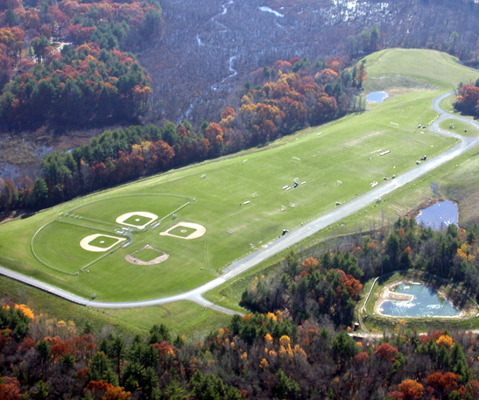
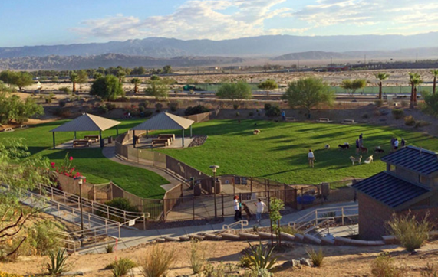
Uses for a Closed Landfill
Recreational uses:
Rodeo grounds
Amateur hobbyists (airplane/glider, drone, kite)
Dog park
Amateur golf course (desert landscape only)
Athletic fields

Slide 20
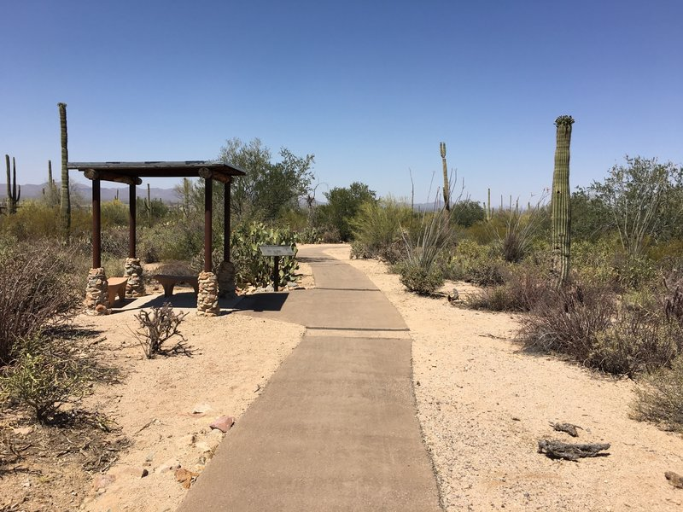
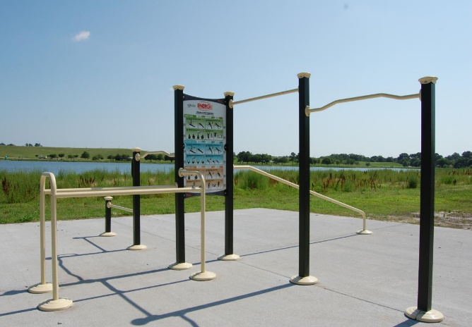
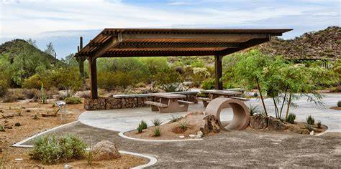
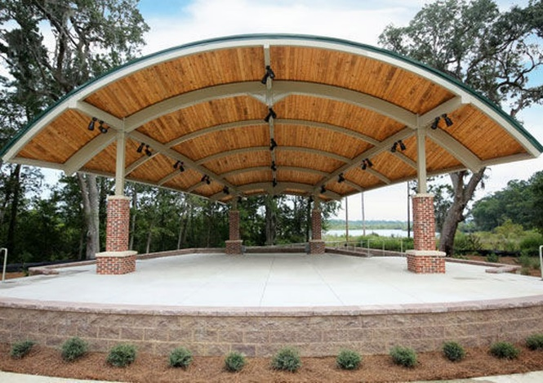
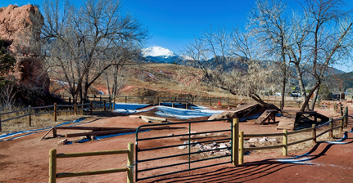
Uses for a Closed Landfill
Recreational uses:
Walking and running trails
Outdoor exercise stations
Outdoor running track
Picnic areas
Amphitheater venue

Slide 21
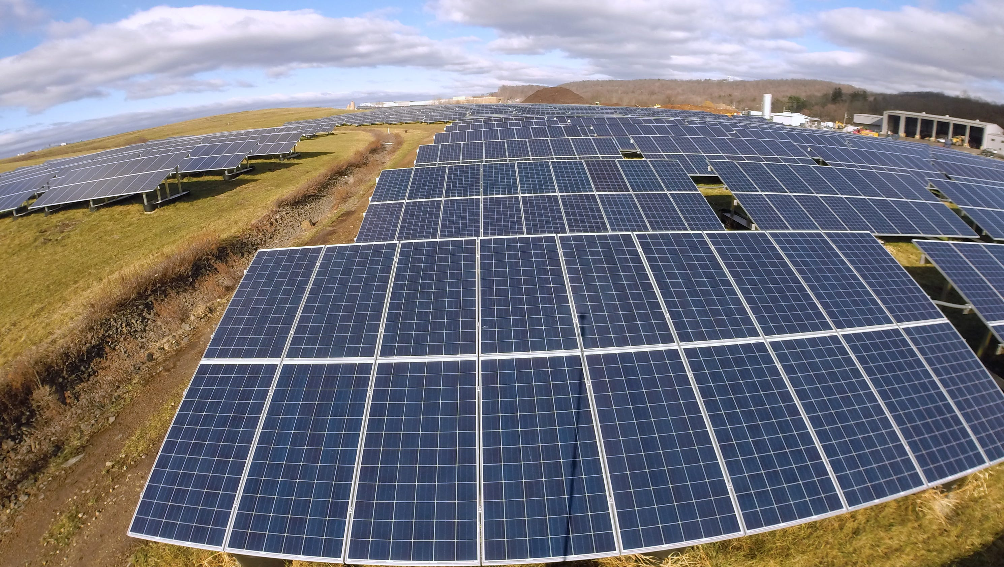
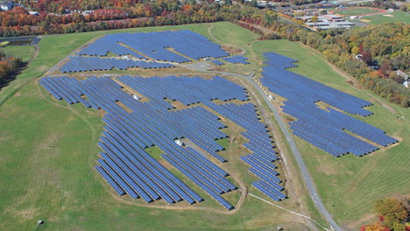
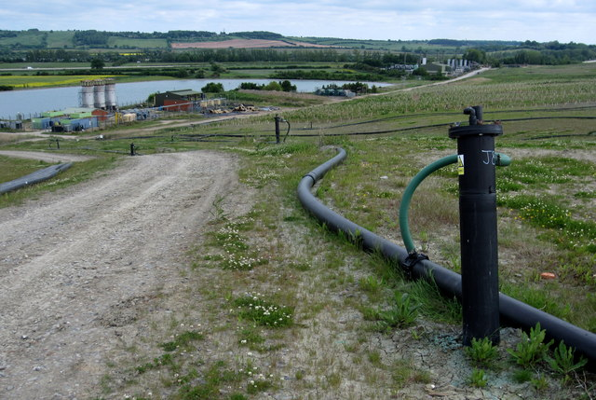
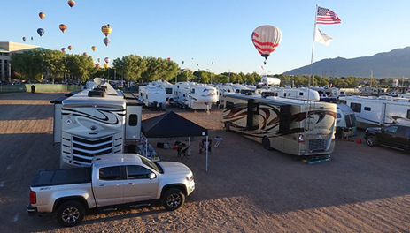
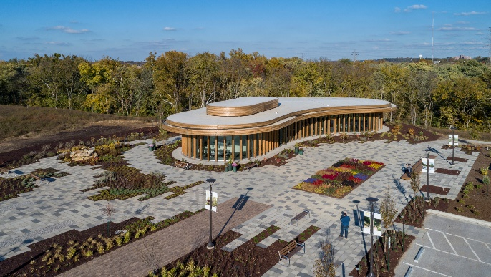
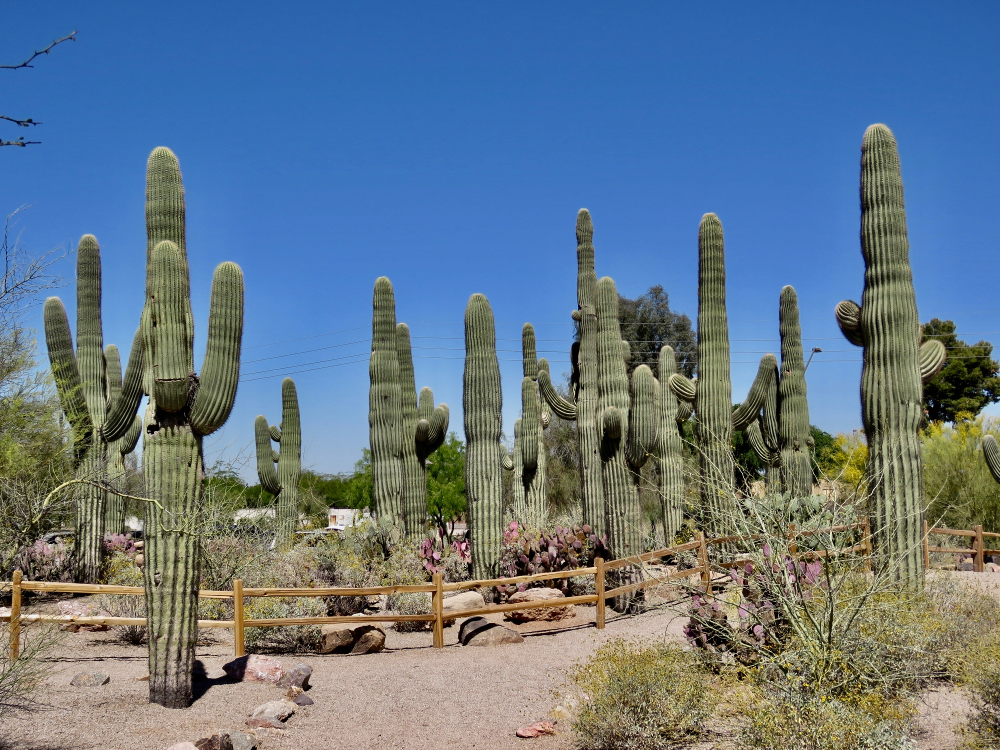
Uses for a Closed Landfill
Energy Production:
Landfill gas recovery facility
Solar panel field
Additional Options:
Agricultural
Preserve / Botanical gardens
Parking lots
Storage facilities

Slide 22
Invite

Slide 23
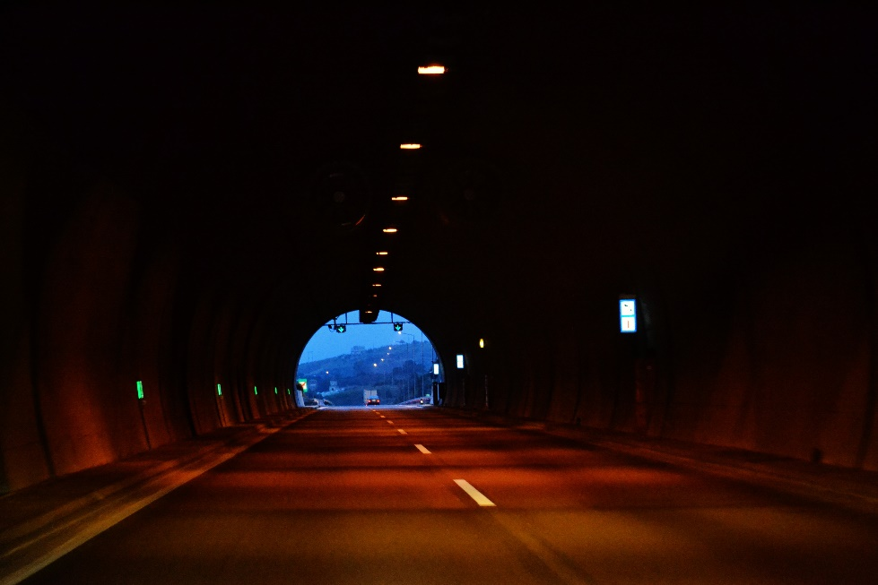
Invite
Tribal Council and the Salt River
Landfill seek your input to help
decide the future of the landfill.
Alternative A: Close at the end of existing contracts?
Alternative B: Operate to the full approved height of 140 feet?
Alternative C: Close the current site and open
a new one?

Slide 24
Invite
Frequently asked questions:
Why not open a new landfill
outside the Community?
Costs are estimated to be 4 times higher than to move the landfill site within the Community.
Very costly and difficult in Maricopa County.

Slide 25
Invite
Frequently asked questions:
Why not keep the landfill open just
for the Community?
It would likely cost the Community far more to keep operating the landfill for its own use than to pay for solid waste disposal elsewhere.

Slide 26
Alternative A
Closure in 2035
Existing contracts with the cities of Mesa and Scottsdale expire in 2035.
The landfill would cease operating at that time.
Notes:
What is closure height estimate for existing landfill? Per Rich landfill would be the height of what the easternmost cell is at currently

Slide 27
Alternative A: Landfill Closes in 2035
Pros | Cons
Maintains current legal contracts with Mesa and Scottsdale. | Landfill not used to full capacity in 2049, resulting in: Loss of well over $100 million in net cash flows to the Community.
Height of landfill at closure approximately 40’ shorter than total height allowed. | Loss of jobs supporting CM households and other Native American households.
Reduces truck traffic, odors, and loose trash. | CMs will likely need to pay for trash service to help cover cost for disposal outside the Community from 2036 onward.

Slide 28
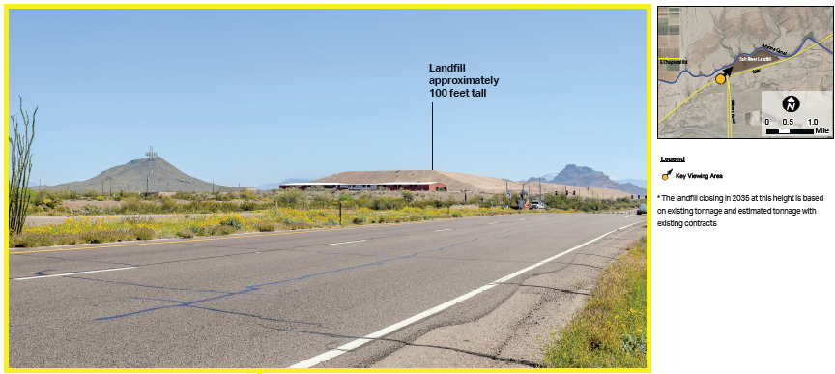
Alternative A – Looking East on SR87

Slide 29
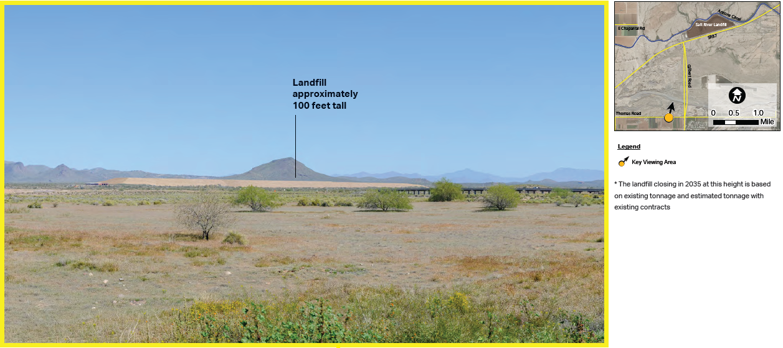
Alternative A – Looking North from Thomas Road in Lehi

Slide 30
Alternative B:
Closure at Full Height
Estimated full capacity in 2049-2050.
The landfill would cease operating upon reaching full height.
Notes:
What is closure height estimate for existing landfill? Per Rich landfill would be the height of what the easternmost cell is at currently

Slide 31
Alternative B Landfill Operates to Full Height Approved by Council
Pros | Cons
Steady, recession-resistant cash flow to the Community of well over $100M from 2036-2049. | Views of landfill, especially from Community residential areas along SR87. Approx. 140 feet above the natural terrain.
Employment supporting CM and other Native American households. | Landfill truck traffic, odors, and loose trash.
CMs may avoid paying for outside trash service until 2049. | After 2049, CMs will likely need to pay for trash service to pay for disposal outside the Community.
No additional capital costs for landfill to be operated to full capacity. | CMs would no longer be able to drop off bulk waste at the landfill after it closes.

Slide 32
Alternative B – Looking East on SR87

Slide 33
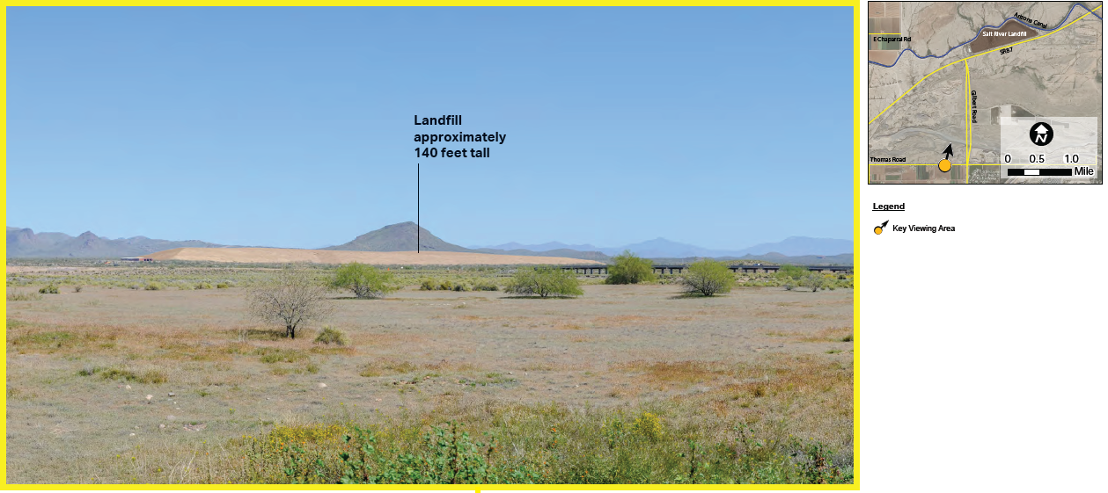
Alternative B – Looking North from Thomas Road in Lehi

Slide 34
Alternative C:
Open a New Landfill
SRLF winds down operations at the current site.
SRLF develops a new, nearby site in the Community.
Notes:
What is closure height estimate for existing landfill? Per Rich landfill would be the height of what the easternmost cell is at currently

Slide 35
Alternative C
Pros | Cons
Community can maximize steady, recession-resistant cash flows of well over $300M through at least 2055. | Loss of additional land space.
Could limit final height of existing landfill to an estimated 90 feet above natural terrain and limit the height of the new landfill. | Views of new and existing landfill—especially from Community residential areas along SR87.
Maintains employment supporting CM and other Native American households. | Costs of designing and constructing a new landfill.
CMs will likely need to pay for trash service to help cover cost for disposal outside the Community from 2036 onward. | Landfill truck traffic, odors and loose trash
 | Environmental Regulatory Burden for new landfill and monitoring of closed landfill

Slide 36
Alternative C:
Important Note:
A new location for a landfill has not been fully studied and has not been approved by Tribal Council.
The following photo simulations for a location just north of the existing landfill are strictly for demonstration purposes.
Notes:
What is closure height estimate for existing landfill? Per Rich landfill would be the height of what the easternmost cell is at currently

Slide 37
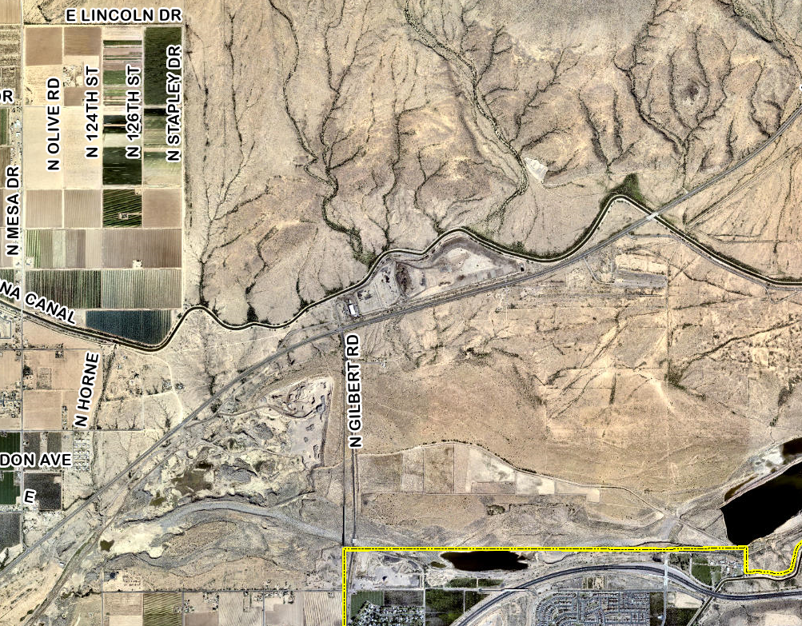
Alternative C New Landfill location (For presentation purposes only.)
New Landfill
Salt River Landfill

Slide 38
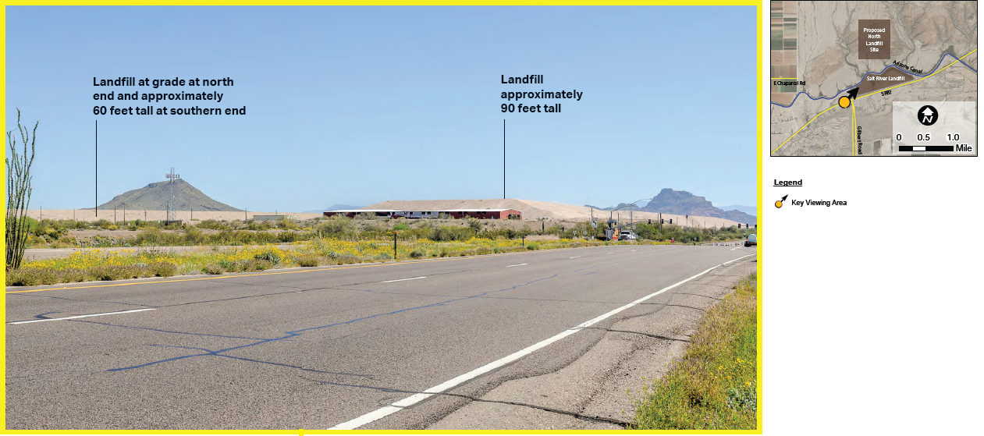
Alternative C – Looking East on SR87

Slide 39
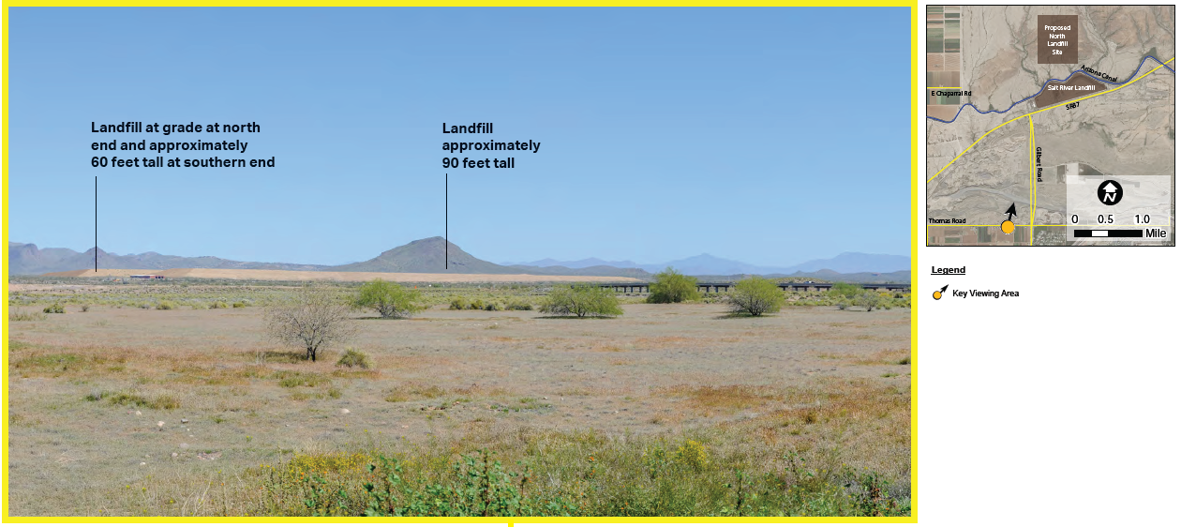
Alternative C – Looking North from Thomas Road in Lehi

Slide 40
Initiate

Slide 41
Initiate
Tribal Council and Salt River Landfill
will:
Gather feedback from Community members.
Consider landfill feedback in conjunction with plans and goals for the Community as a whole.
Prepare a strategic plan for the landfill’s future.

Slide 42
Thank You for Your Opinions and Comments!
Watch this presentation again or share with others by visiting: https://www.srpmic-nsn.gov/government/1879-phc/. The presentation will be available until December 31st, 2023 for comments and input.
Provide additional comments and questions:
By Phone-- (623) 282-5757
By Text-- 623-282-5757
By Email--- public_hearing_comments@SRPMIC-nsn.gov
By Mail-- Send your written comments to Attn: Public Comments-Landfill, Community Development Department, 10005 E. Osborn Rd, Scottsdale AZ, 85256

